Slide 1
Customers Segmentation & Clustering Analysis
MACHINE LEARNING

Slide 2
ABSTRACT:
Customer segmentation is one of the key aspects business supporter system in this project we are using python language, clustering Techniques, by which the several segments of the customers are allowing them to target the possible users. In this data science project, it will make use of K-means clustering which is the essential algorithm for clustering the datasets. We are using one way to segment the customer as demographics like age, gender, customer ID, annual income and spending score.

Slide 3
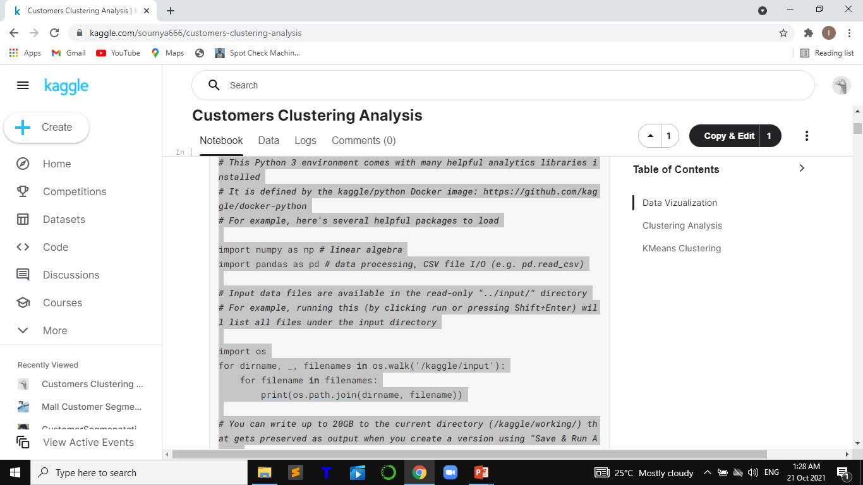

Slide 4
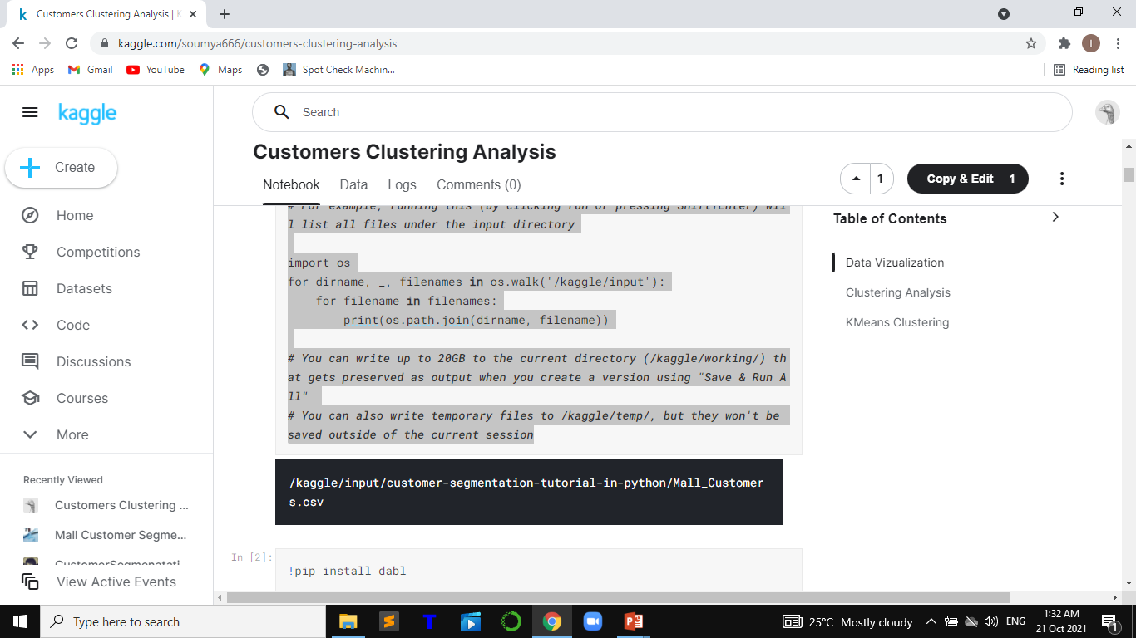
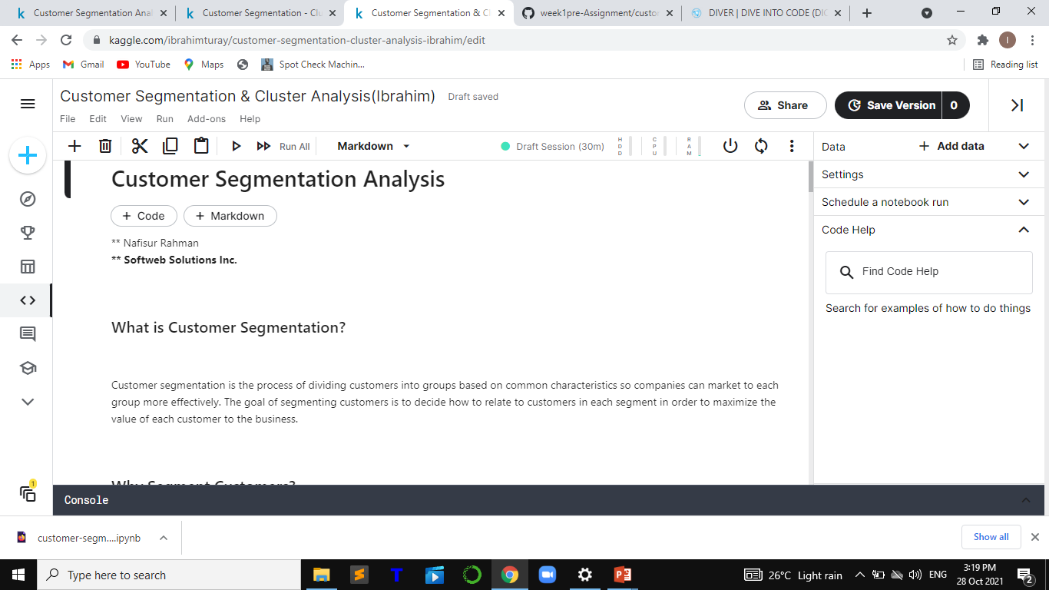

Slide 5
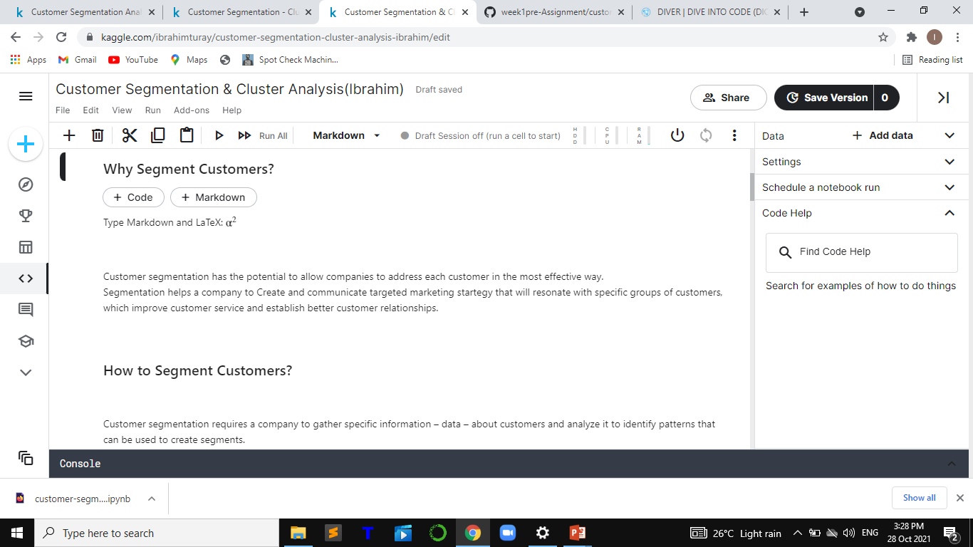
Why Customer segmentation?

Slide 6


Slide 7
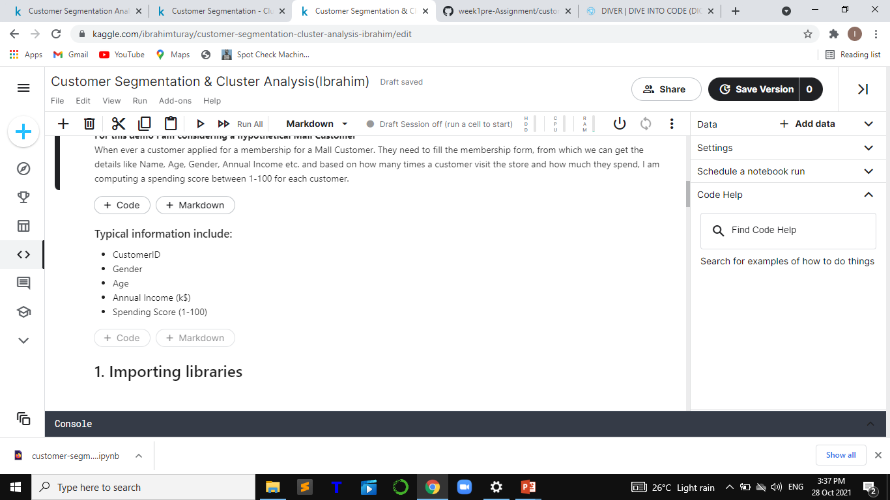

Slide 8
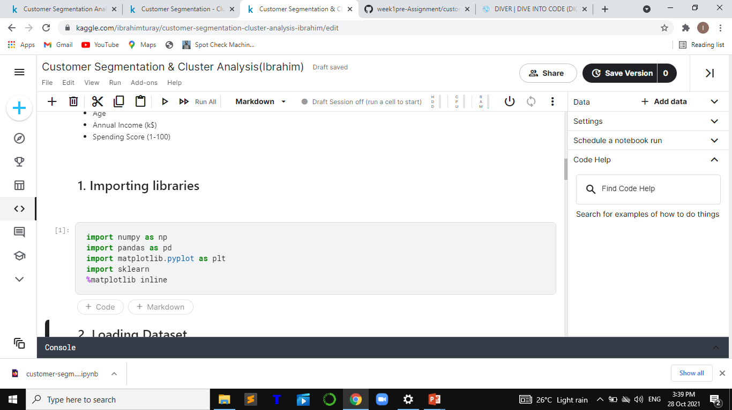
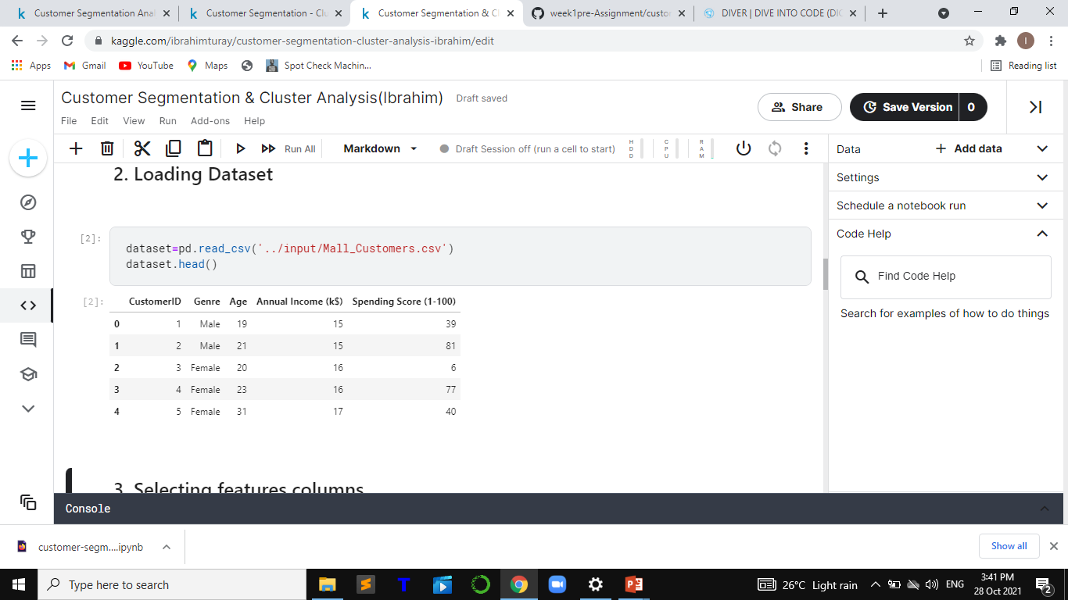

Slide 9
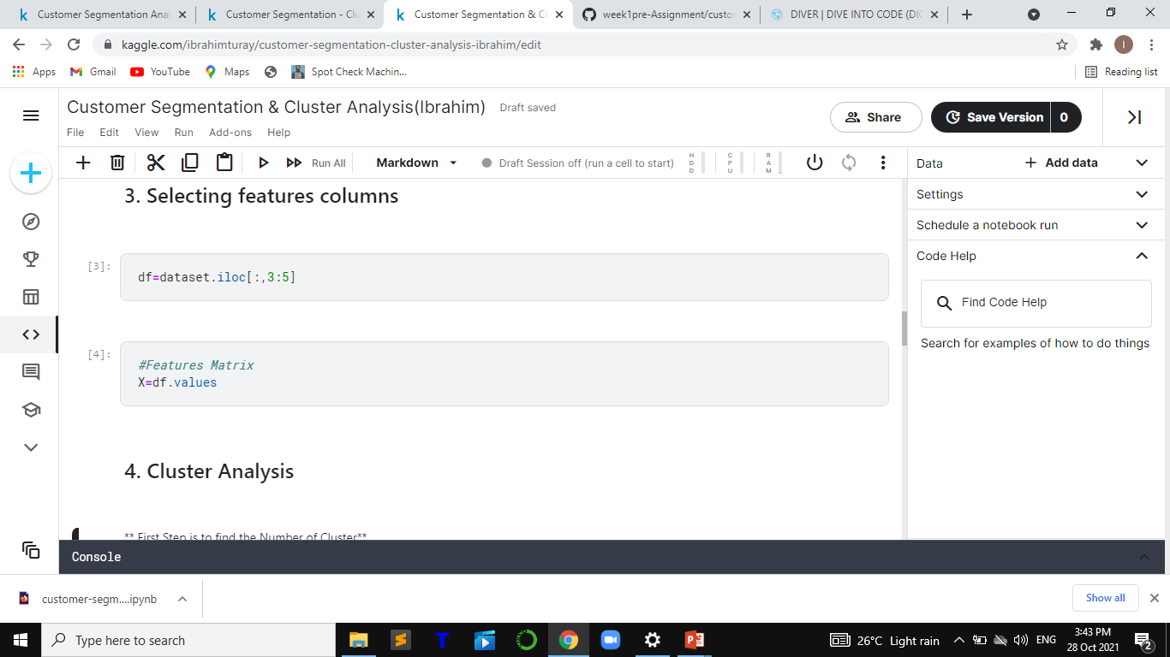
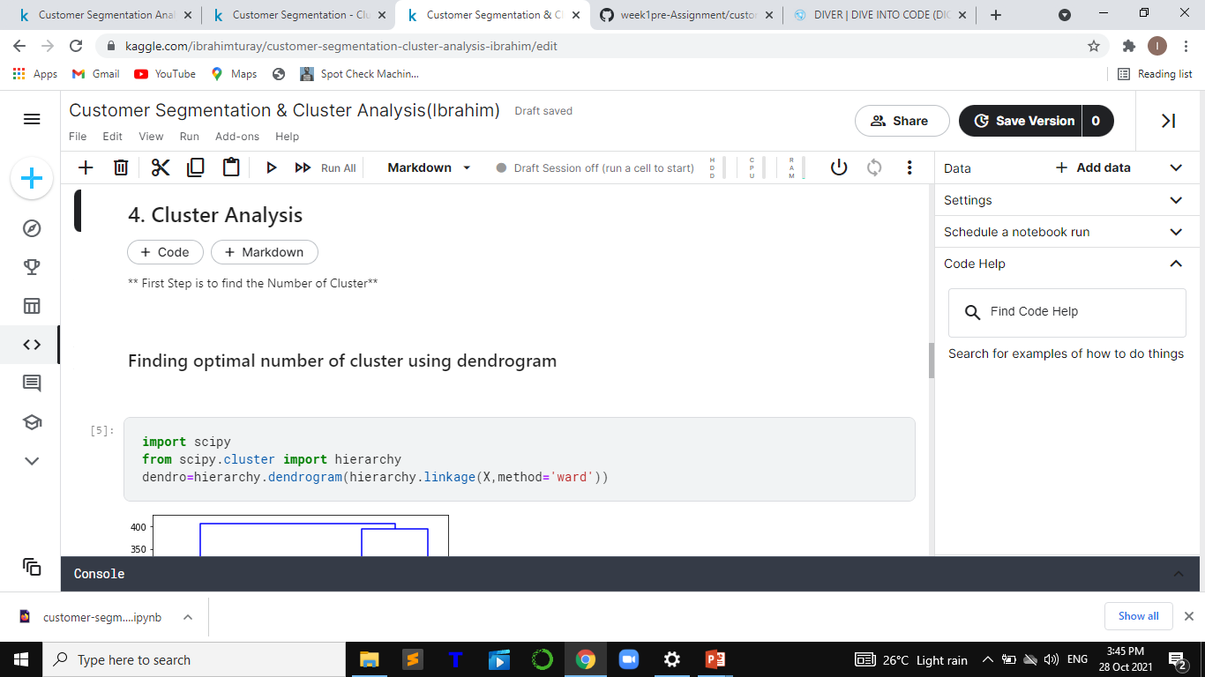

Slide 10
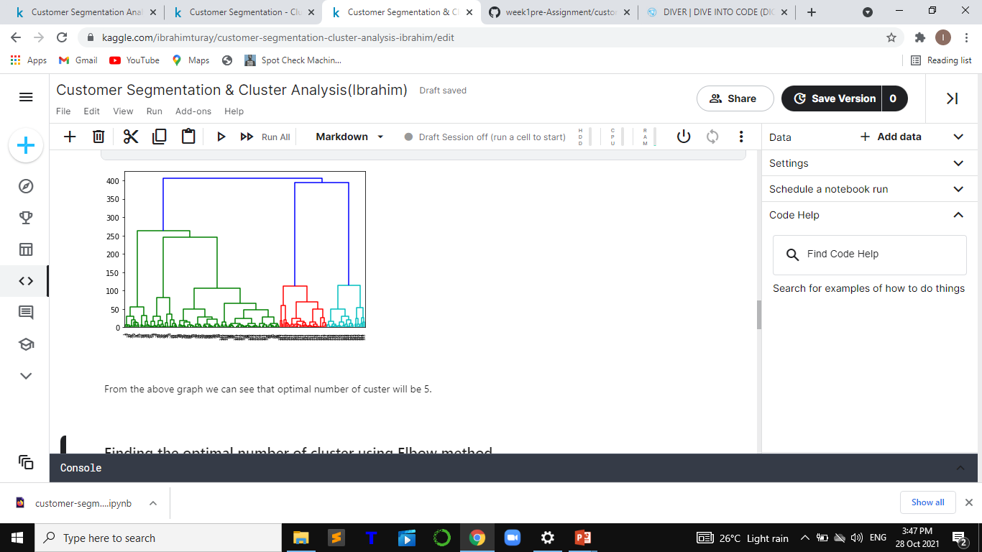

Slide 11
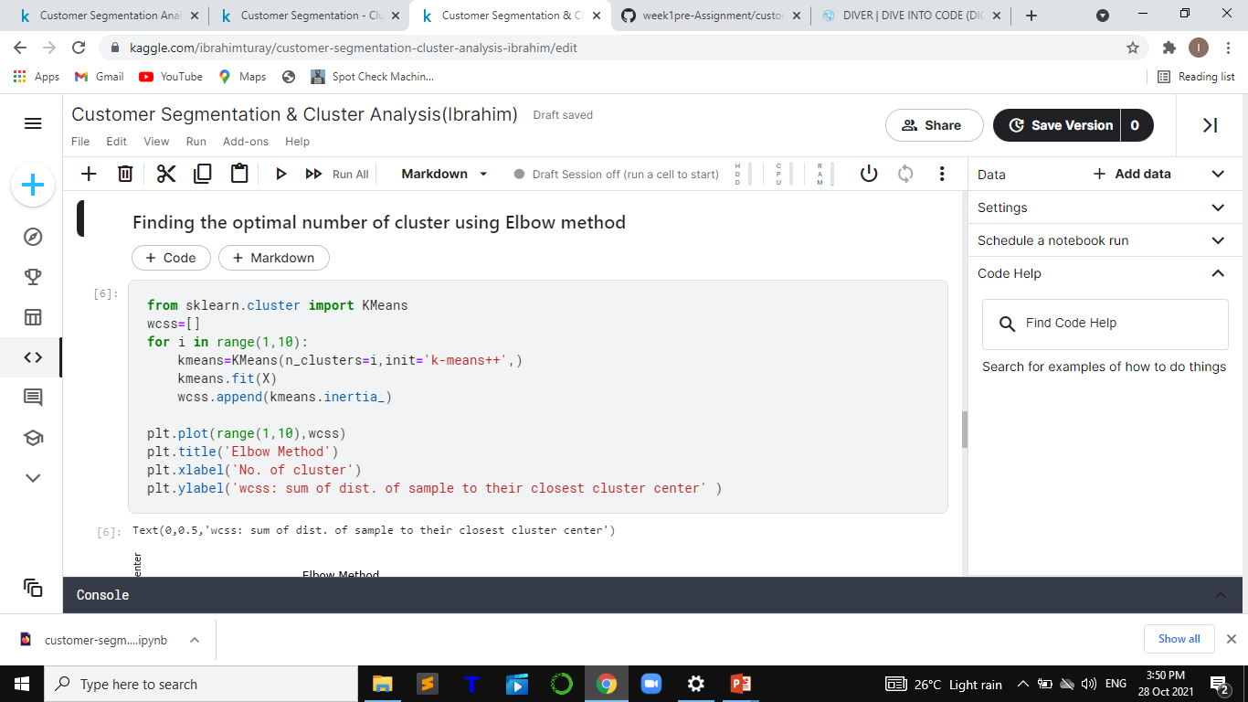

Slide 12
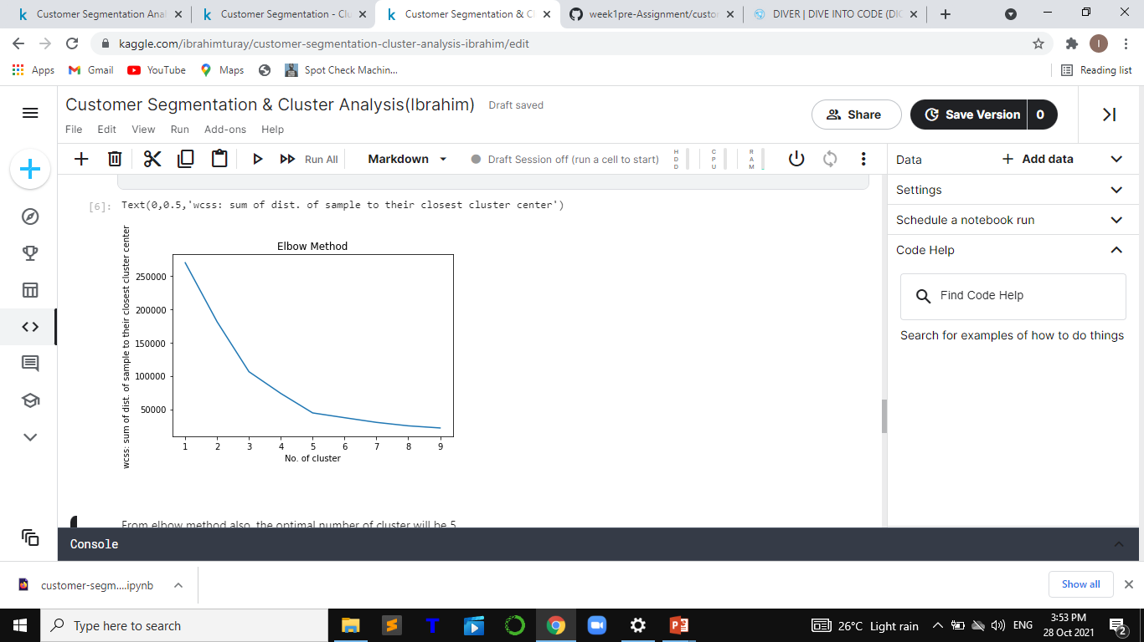

Slide 13
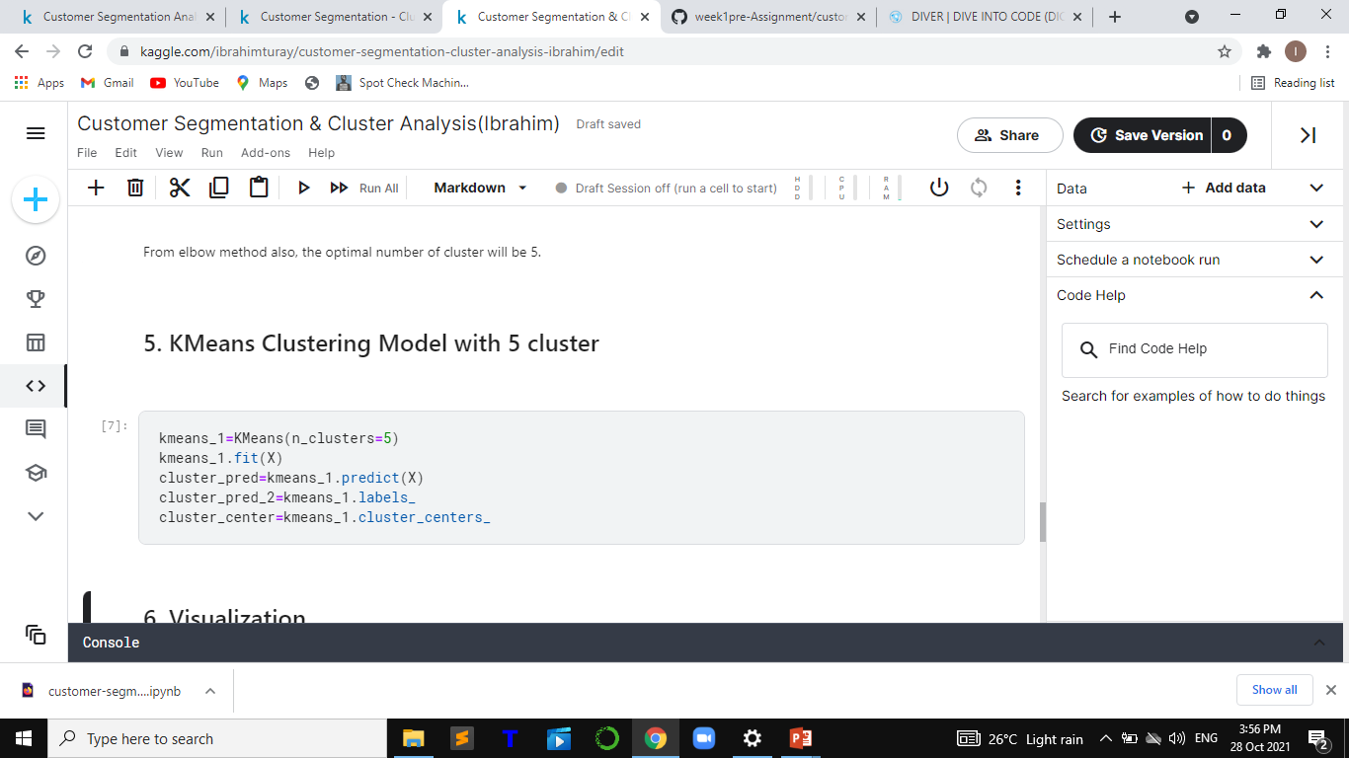

Slide 14
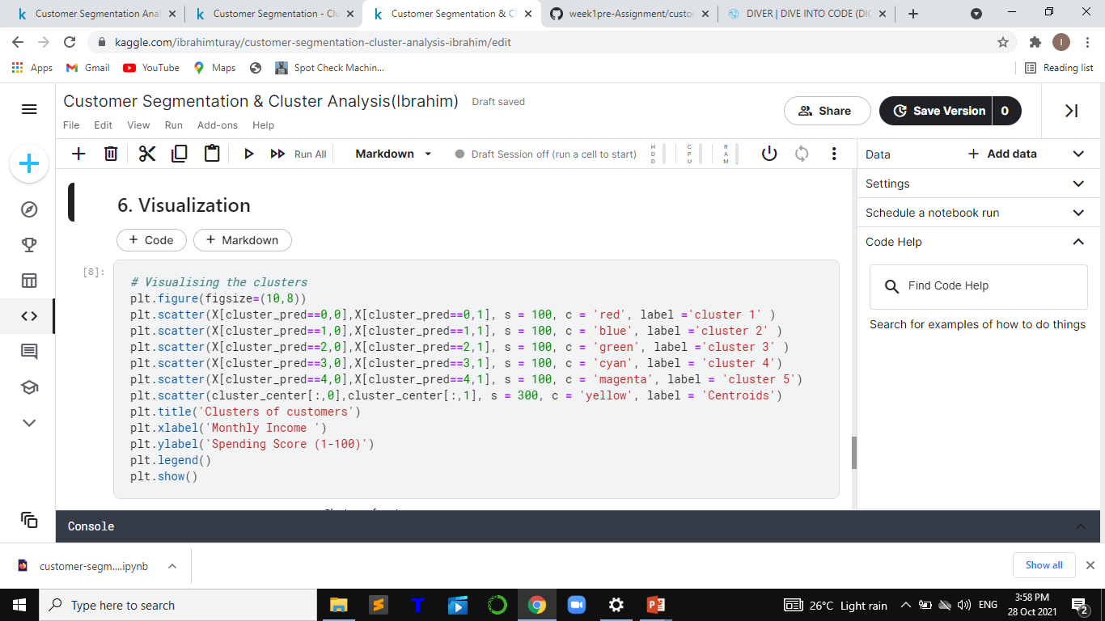

Slide 15
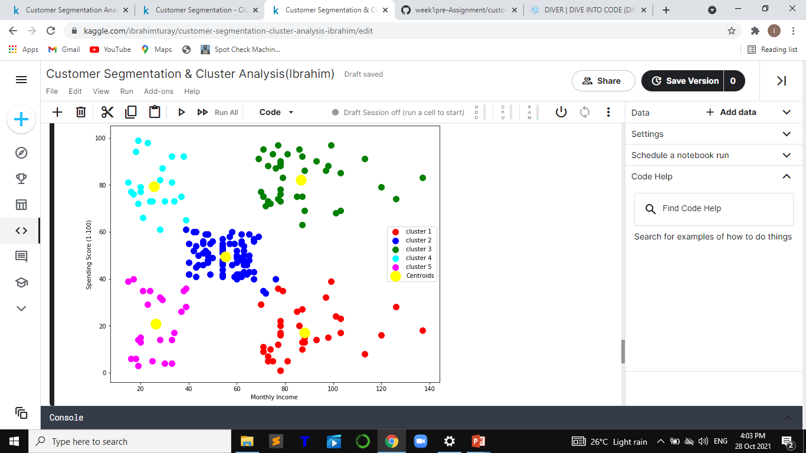
Clusters of customers

Slide 16
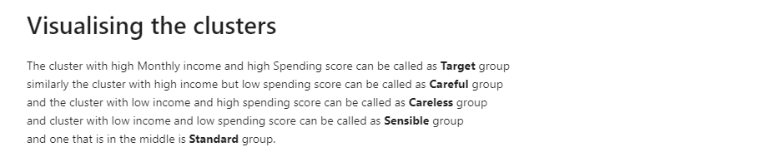


Slide 17
CONLUSION:
The given datasets of this customer segmentation is successfully processed by the using K-means clustering algorithm. And it help to improve customer service.
K- mean algorithm is one of the most popular clustering algorithms and normally the first thing practitioners apply when solving clustering tasks to get an idea of the structure of the datasets. The goal of K- means is to group data points into distinct non- overlapping subgroups. One of the major application of K- means clustering is segmentation of customers to get a better understanding of them which in turn could be used to increase the revenue of the company.
I could not use dataset of sierra Leone, but in the future, since I have build a model, I am planning to use a real dataset from customer segmentation and cluster analysis in Sierra Leone.

Slide 18
MACHINE LEARNING
GRADUATION ASSIGNMENT
Project
End of Session
DIVE INTO CODE
IBRAHIM TURAY

